Slide 1
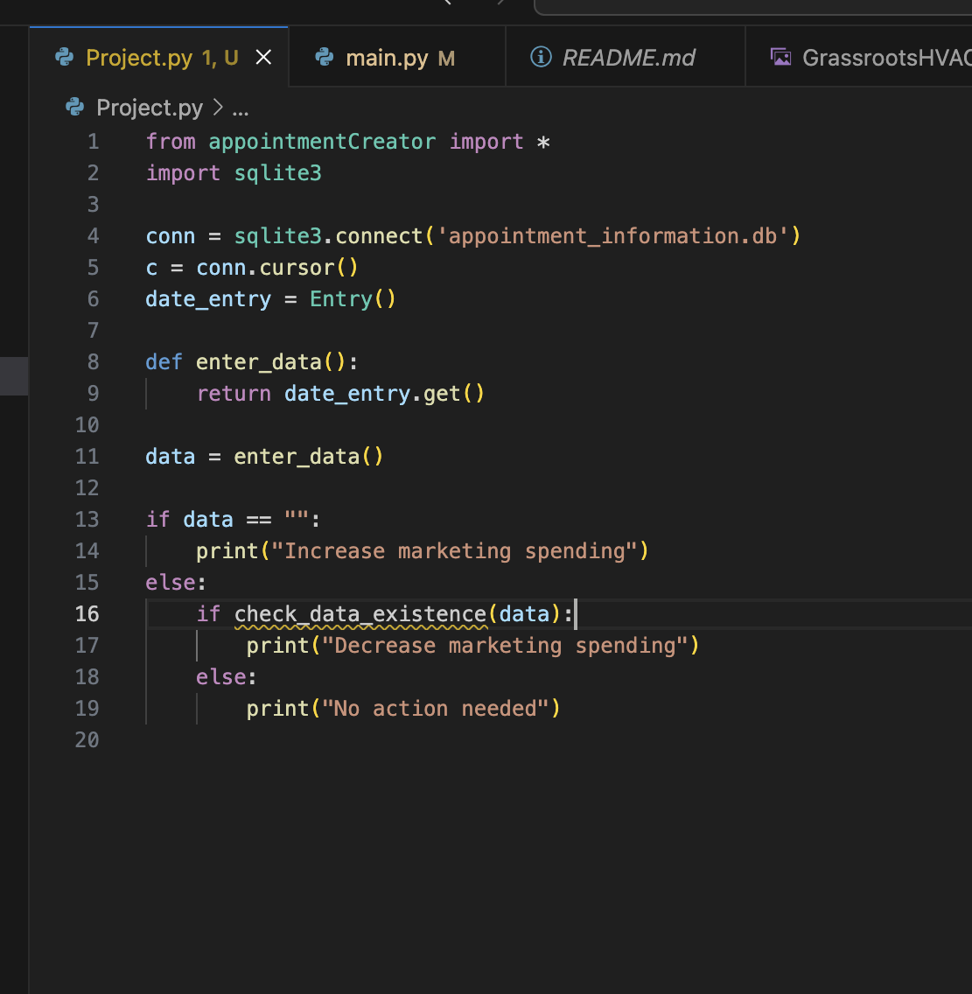
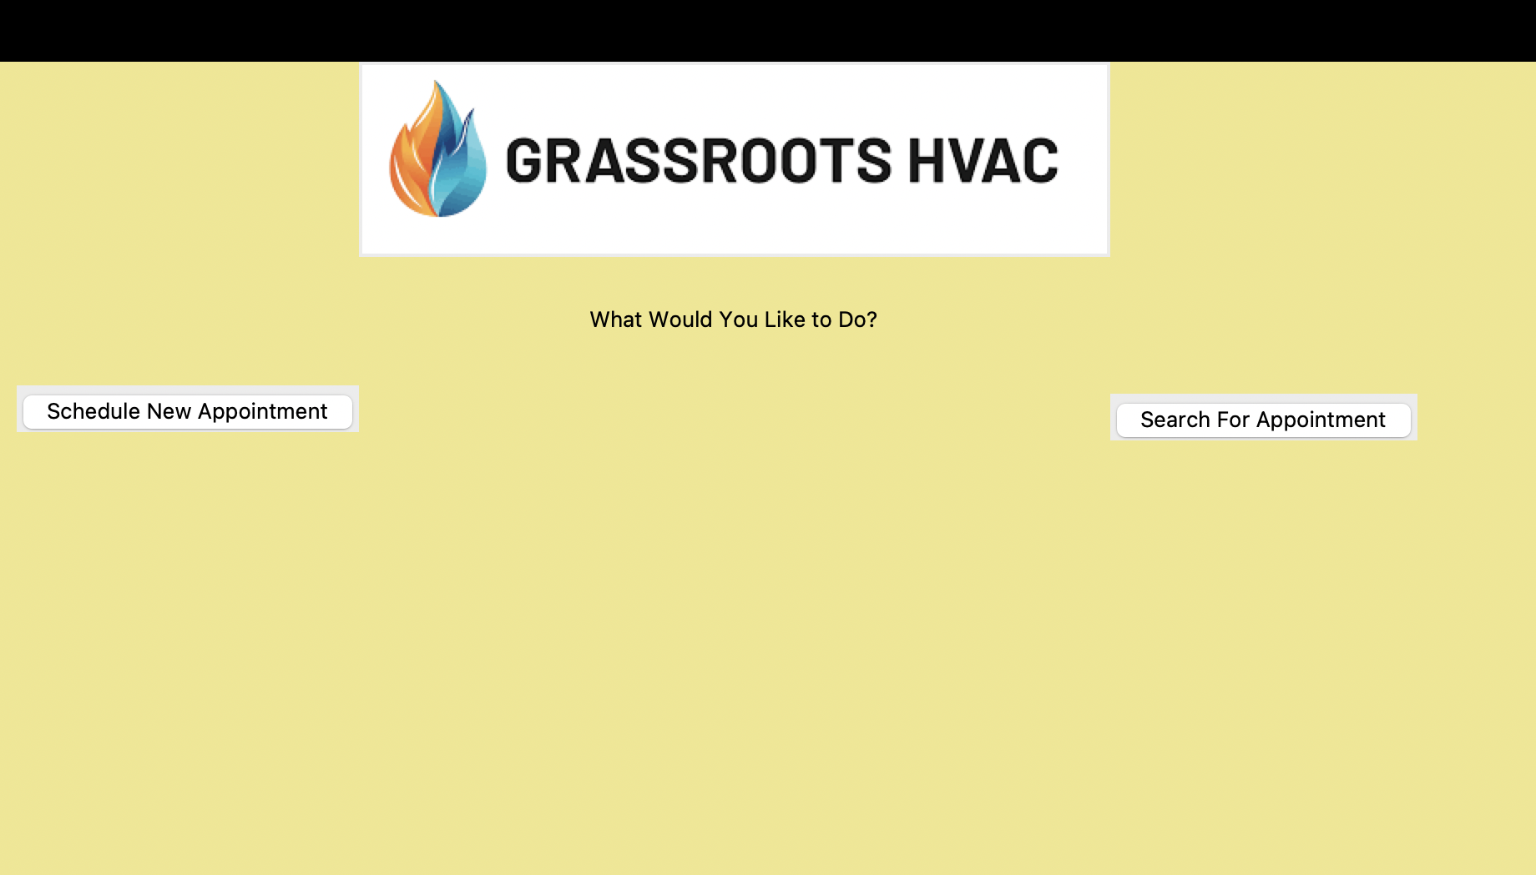
Schedule Based Marketing Adjustment
Team Members: Joshua Smith
This Code aims to adjust marketing spending based on scheduling availability, allowing for increased marketing efficiency due to cost being decreased when fully booked.

